Slide 1
ARCHIMEDES 2000
The world’s most complete and advanced
Multifunctional mini-pool, easily transportable and placeable in any suitable location for motorial rehabilitation (and not only) with a controlled segmental load
conceived and created by Stefano weisz m.d.

Slide 2
ARCHIMEDES 2000
Currently most Original and innovative device in the world conceived for the development and integration of the most advanced motorial rehabilitation techniques and many others pathological conditions.
It allows easily personalized therapeutic protocols, adaptable to every type of patient.

Slide 3
The device consists of two parts in continuity with each other. 1) The upper one has the form and dimensions of a common rehabilitation pool in horizontal position 2) The lower one has the shape of a parallelepiped

Slide 4
The «WALKING HYDRO SYSTEM» consists of a platform whose position is vertically adjustable: in the upper one it forms the bottom of the upper tank allowing treatments in a horizontal position; moving downwards will allow the patient to pass from the horizontal position to the vertical quickly and in total comfort and safety. It is also provided with a treadmill with variable speed in both directions.

Slide 5
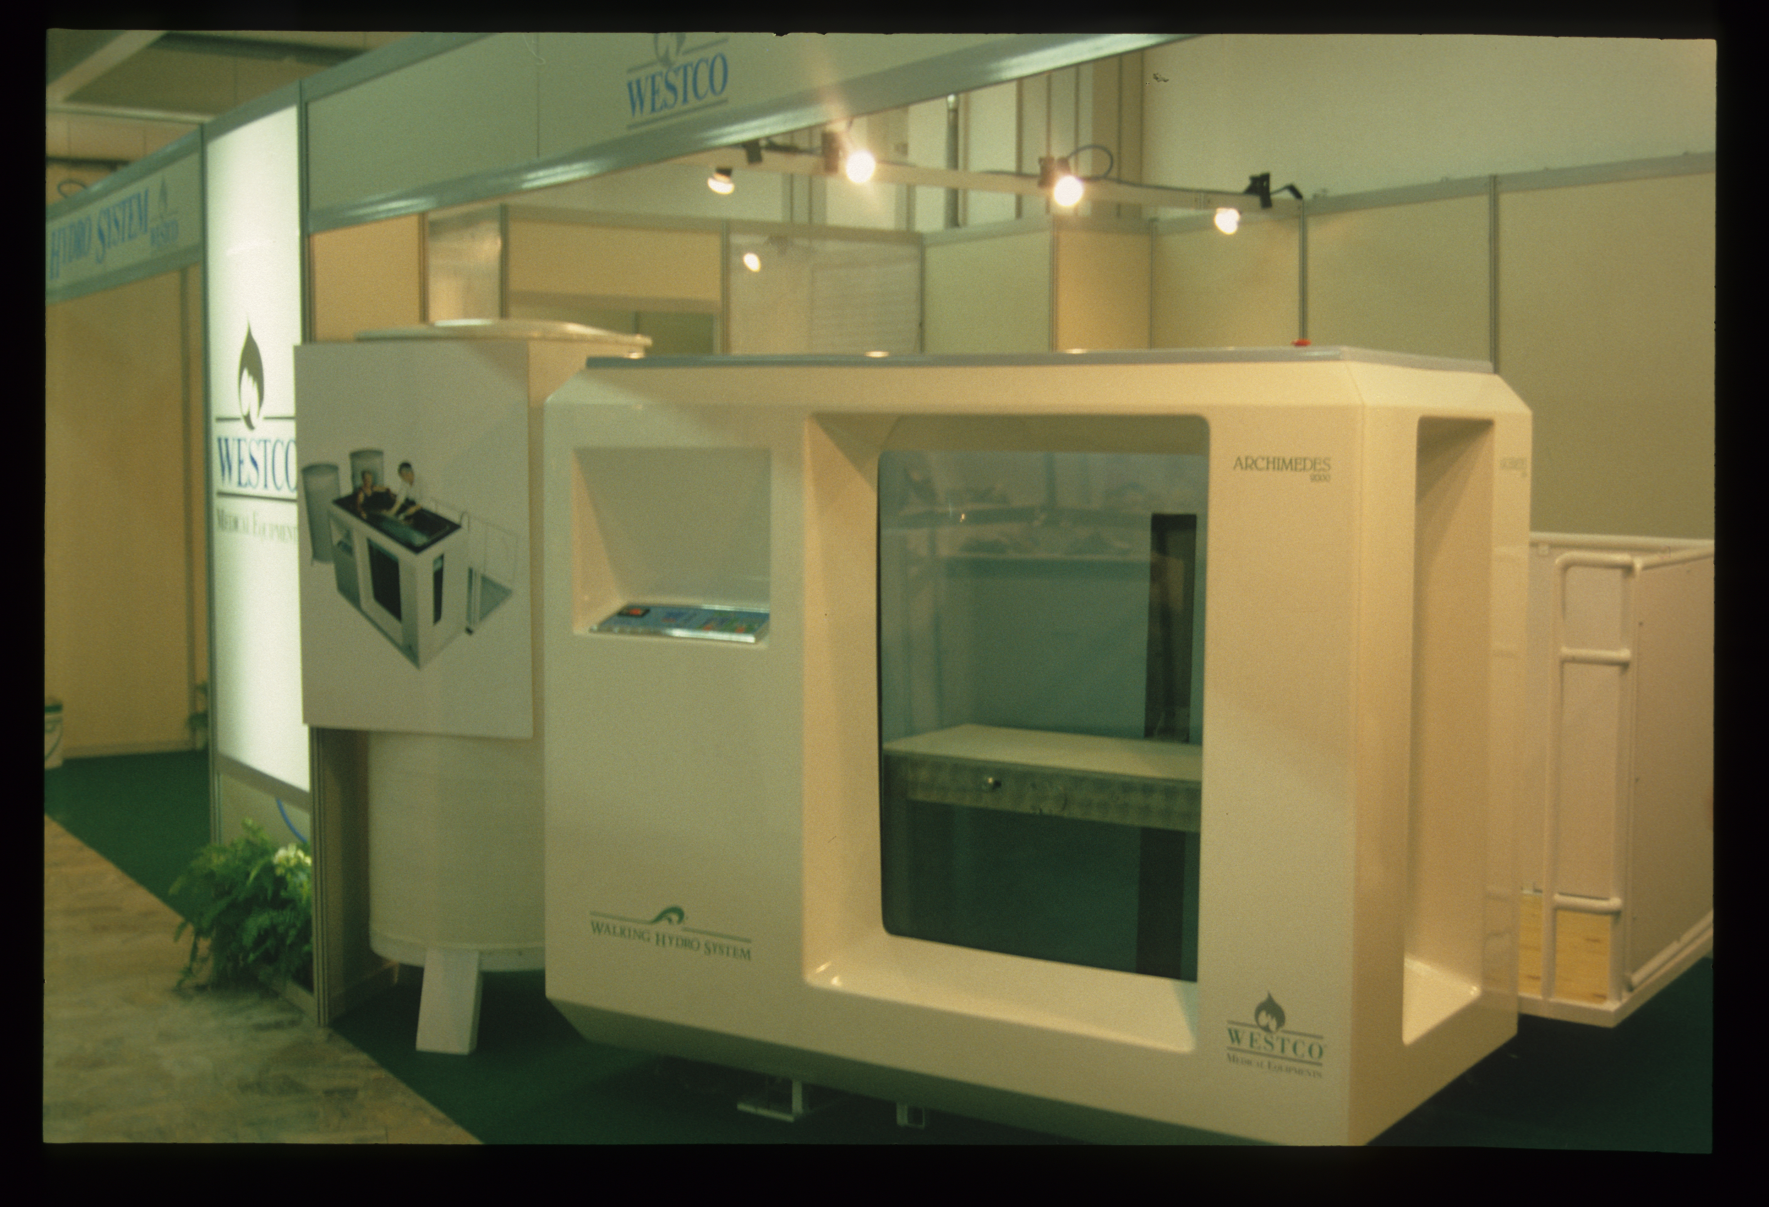
MEETS, ENHANCING, THE ADVANTAGES OF THE CURRENT POOLS, AVOIDING THEIR DISADVANTAGES!

Slide 6
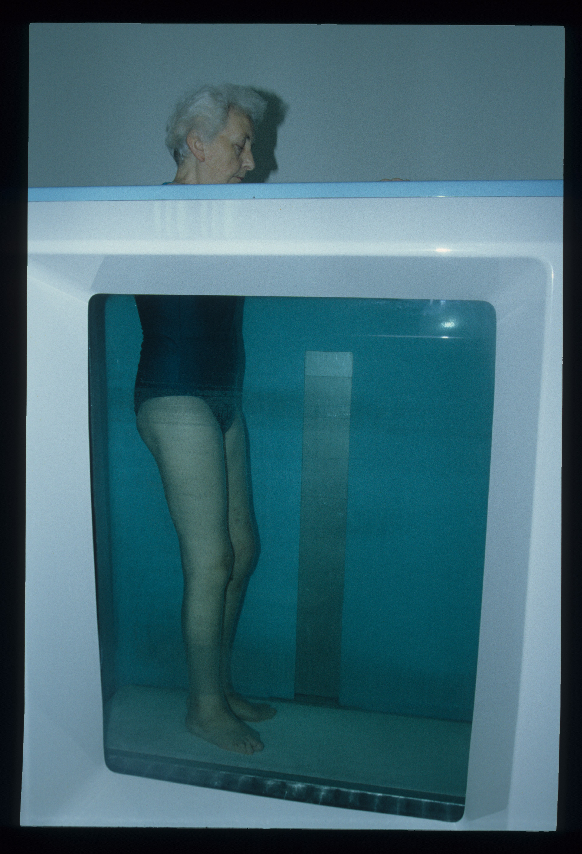
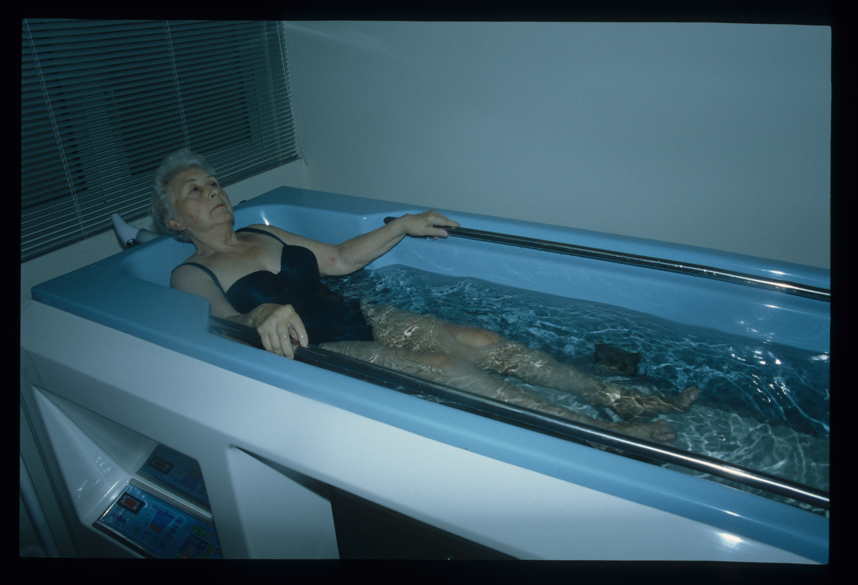
Variable platform positioning

Slide 7
The variable depth position of the platform allows the operators to dose, in an easy, fast and precise way, the load to be obtained according to the customized protocols, and therefore optimal for the different therapeutic indications, according to the
PRINCIPLE OF ARCHIMEDES

Slide 8
By immersing the patient, whose weight is known, at the desired depth, the volume of displaced water can be measured with adequate precision and then, by means of a simple subtractive calculation, we can know the load to which his body is subjected to that level of immersion.
PRINCIPle of ARCHIMEDEs

Slide 9
APPLICATION FIELDS
ARCHIMEDES 2000

Slide 10
Patients subjected to a partial or total arthroprosthesis (hip, knee and ankle), lower limb ligaments or mioplasty. Post-traumatic outcomes in the dorsal-lumbar spine, pelvis and lower limbs surgically treated or not. Patients immediately or deferred surgically treated with osteotomies, tendon transpositions, dorso-lumbar spine, etc. Congenital or acquired osteochondrites of the hip, knee and foot. Many other pathologies to be identified.
orthopedics and traumatology

Slide 11
Venous and lymphatic insufficiencies. Phleboartrosic syndromes. Post-phlebitic syndromes. Liposclerosis (cellulitis). Other pathological situations.
vascular surgery and phlebology

Slide 12
Pathologies due to prolonged hospitalization such as joint stiffness and muscle atrophy and prevention of bedsores. Arthrosis and Osteoporosis and arthritic syndromes in all their forms. After-effects of neurological deseases like strokes, hemiparesis, paraparesis, etc ... Cardiological diseases resulting from myocardial infarction. After-effects of burns.
Internal and geriatric medicine

Slide 13
Strengthening of athletic performances. Control of cardiorespiratory and other physiological parameters under controlled and predetermined effort.
Sports activities

Slide 14
The rationalization and standardization of rehabilitation methods will allow to draw up personalized therapeutic protocols, scientifically more precise and controllable, with safety and hygiene levels unattainable with current systems, as well as with less discomfort for patients.
Therapeutic protocols

Slide 15
Benefits for patients
With Archimedes 2000, being possible to measure with precision and quickly the hydrostatic thrust and therefore the load forces at the level of the segments affected by the rehabilitation program, it will be possible to easily, safely and effectively the precocious and controlled load in order to obtain a faster recovery of the sick to social and active life.
Improvement of hygiene levels with the rapid exchange of water, or its better disinfection in case of its reuse for subsequent treatments.
If necessary ensures the total respect for privacy. Patients more collaborative and satisfied for their functional recovery.

Slide 16
Avoiding the immersion of the staff, improves their comfort without renouncing the safety and efficacy of the cures. More simple and precise execution of personalized therapeutic and rehabilitation programs with the control of the parameters on the edge of the pool or remotely using manual or automatic remote controllers, single or multiple in case of more devices in the same site.
Benefits for operators

Slide 17
Reduced time for hospitalization of patients and back faster to work or parental care due to a significant reduction and optimization of rehabilitation times. Reduction of invalidating consequences caused by accidents at work, road, domestic and at all other situations. Lower costs for public and private insurance.
Benefits for society

Slide 18
ARCHIMEDES 2000 is the most advanced, innovative and effective equipment in the hydrotherapeutic treatments, easily transportable and positioned wherever necessary, applied mostly, but not only, to the functional recovery of the patients traumatized to the dorsal-lumbar spine and lower segments, as well as many other pathological situations. It deserves to enter with full rights into all hospitals, clinics, hydrothermal and outpatient rehabilitation centers. It will also be very useful and appreciated in wellness, thermal, gyms and sports centers for athletic preparation at all levels, from amateur to professional ones with competitive goals.
Final considerations

